Slide 1
Environment Logger Summary, Tests, and Calibration
T. Barrett

Slide 2

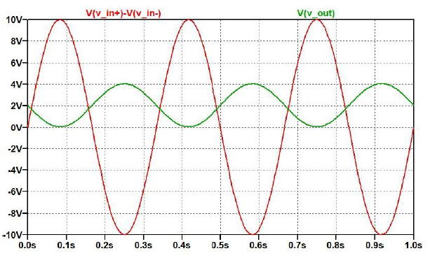

Simplified Schematic
PT100 temperature probe
Post to remote InfluxDB database via ethernet
MAX31865 PT100 digital converter
25k
Gain = x 0.2
BX FIELD
Bartington Fluxgate
SPI digital comm.
± 70 µT
15 bit ADC (32,768 counts)
125k
Arduino Mega
+0.048 V to +4.048 V
I2C digital comm.
± 10 V
BNC
125k
1 count = 4.4 nT
50k
Stable 2.048V reference
50k
LTSpice
…
Repeat for BY on channel 2
…
Repeat for BZ on channel 3

Slide 3
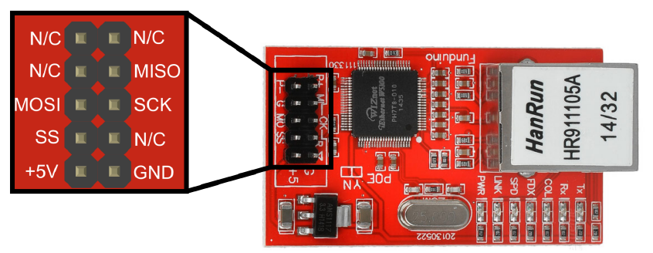
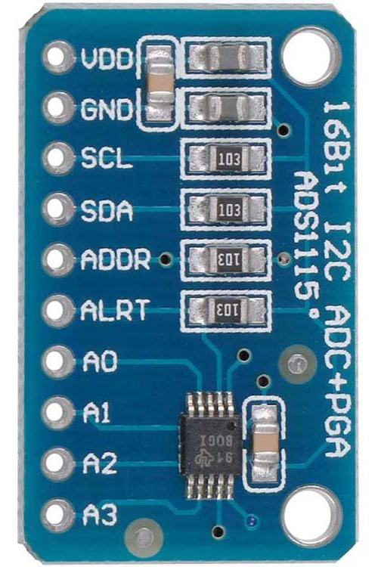
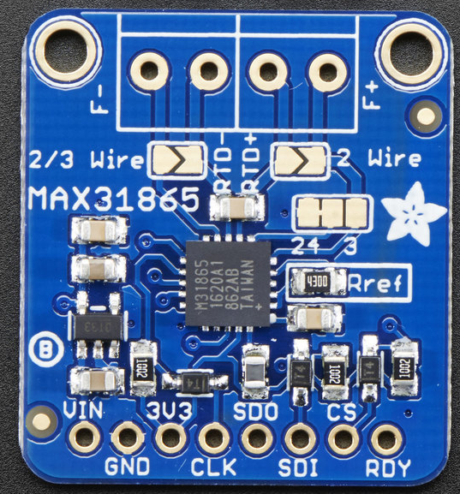
Microcontroller Pins Required
ADS1115 (4 channel ADC)
Mini W5100 (LAN chip)
2-wire I2C
SPI
SCL (serial clock)
SDA (serial data)
VDD (+5V)
GND
CLK
MISO
MOSI
CS (use pin 10, because it’s defined in Arduino library)
VDD (+5V)
GND
MAX31865 (PT100 amplifier)
SPI
CLK
MISO
MOSI
CS
VDD (+5V)
GND
Arduino Mega hardware SPI pins:
CLK
52
MISO
50
MOSI
51
Can use hardware SPI or software SPI. Hardware SPI is faster, because there is an internal peripheral device designed to shift the bits out and generate the signals.
Arduino Mega I2C pins:
SCL
D21
SDA
D20

Slide 4
Microcontroller Memory Required
Ethernet sketch requires 18,294 bytes
Temperature sketch requires 4,004 bytes
ADC sketch requires 3,236 bytes
Total is 32,550 bytes…
(more than available on Nano… need to use Arduino Mega)
Basic OLED sketch requires 7,016 bytes
Arduino Nano has 32 KB flash memory (2 KB used by bootloader). So, 30,720 bytes available for program. This is equivalent to 30.72 kilobytes, or 30 kibibytes.
Arduino Mega has 256 KB memory (8 KB used by bootloader). So should be 248 kibibytes available to use. Which is 248 x 1024 = 253,952 bytes.

Slide 5
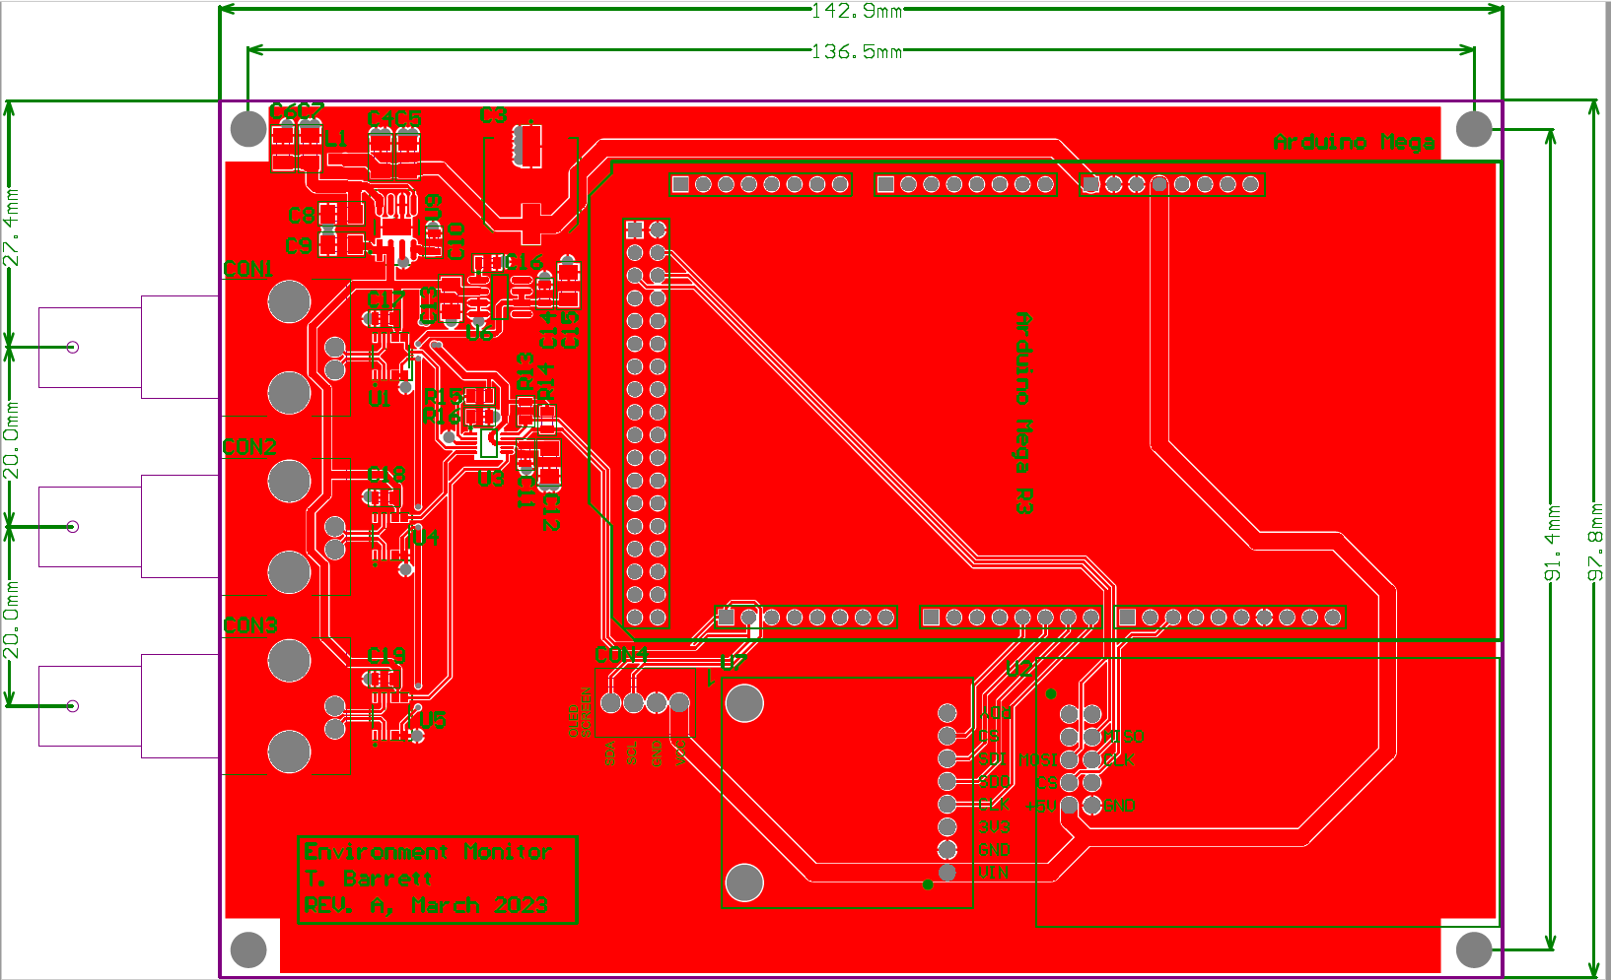
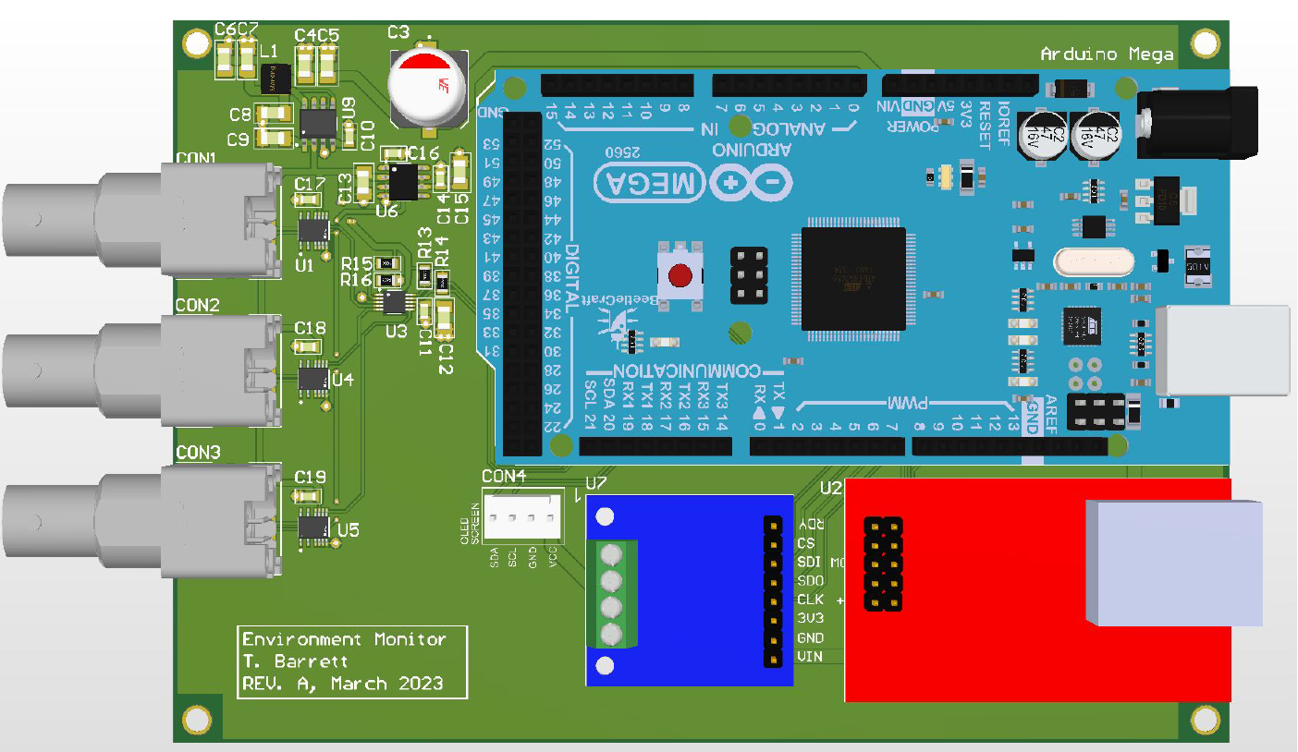
PCB Design

Slide 6
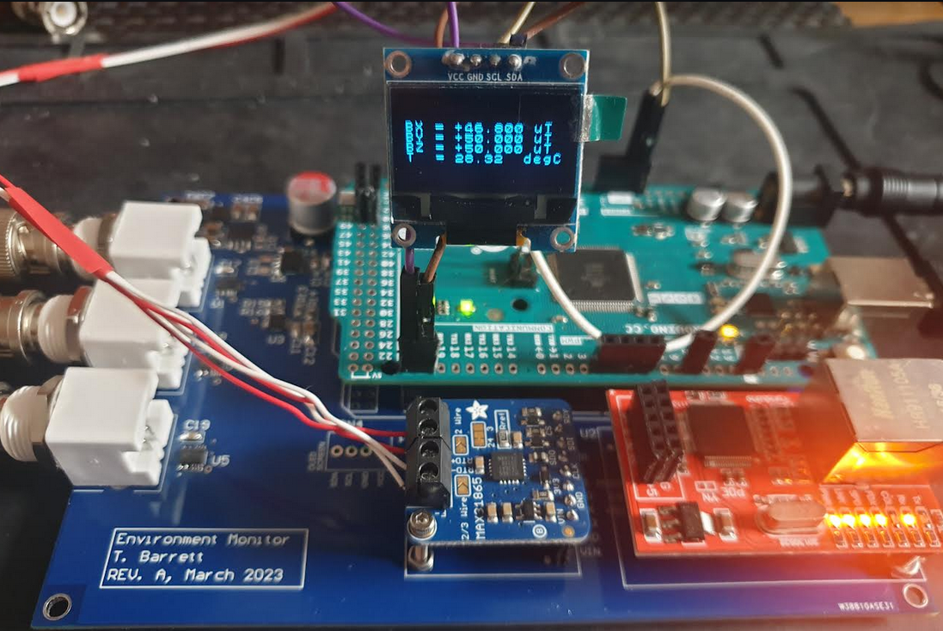
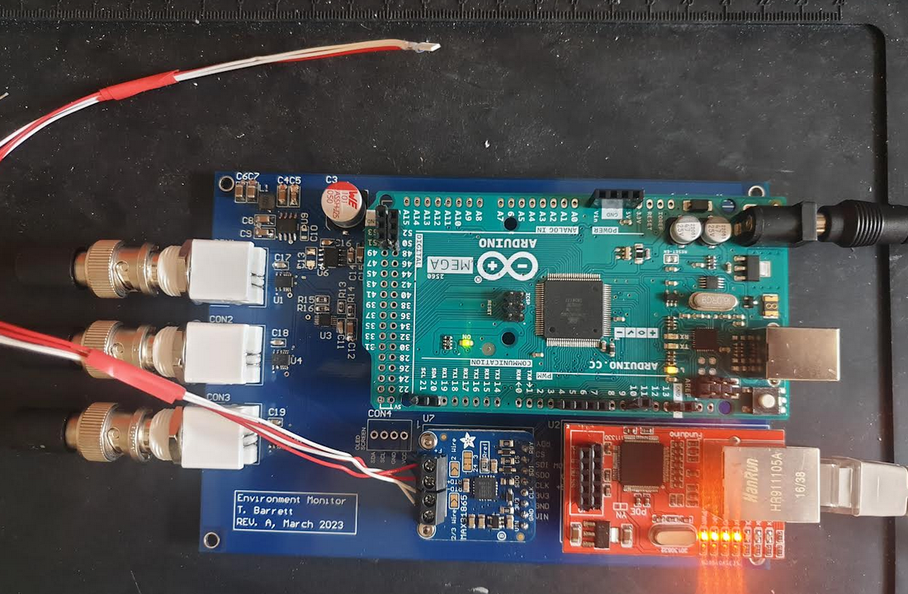
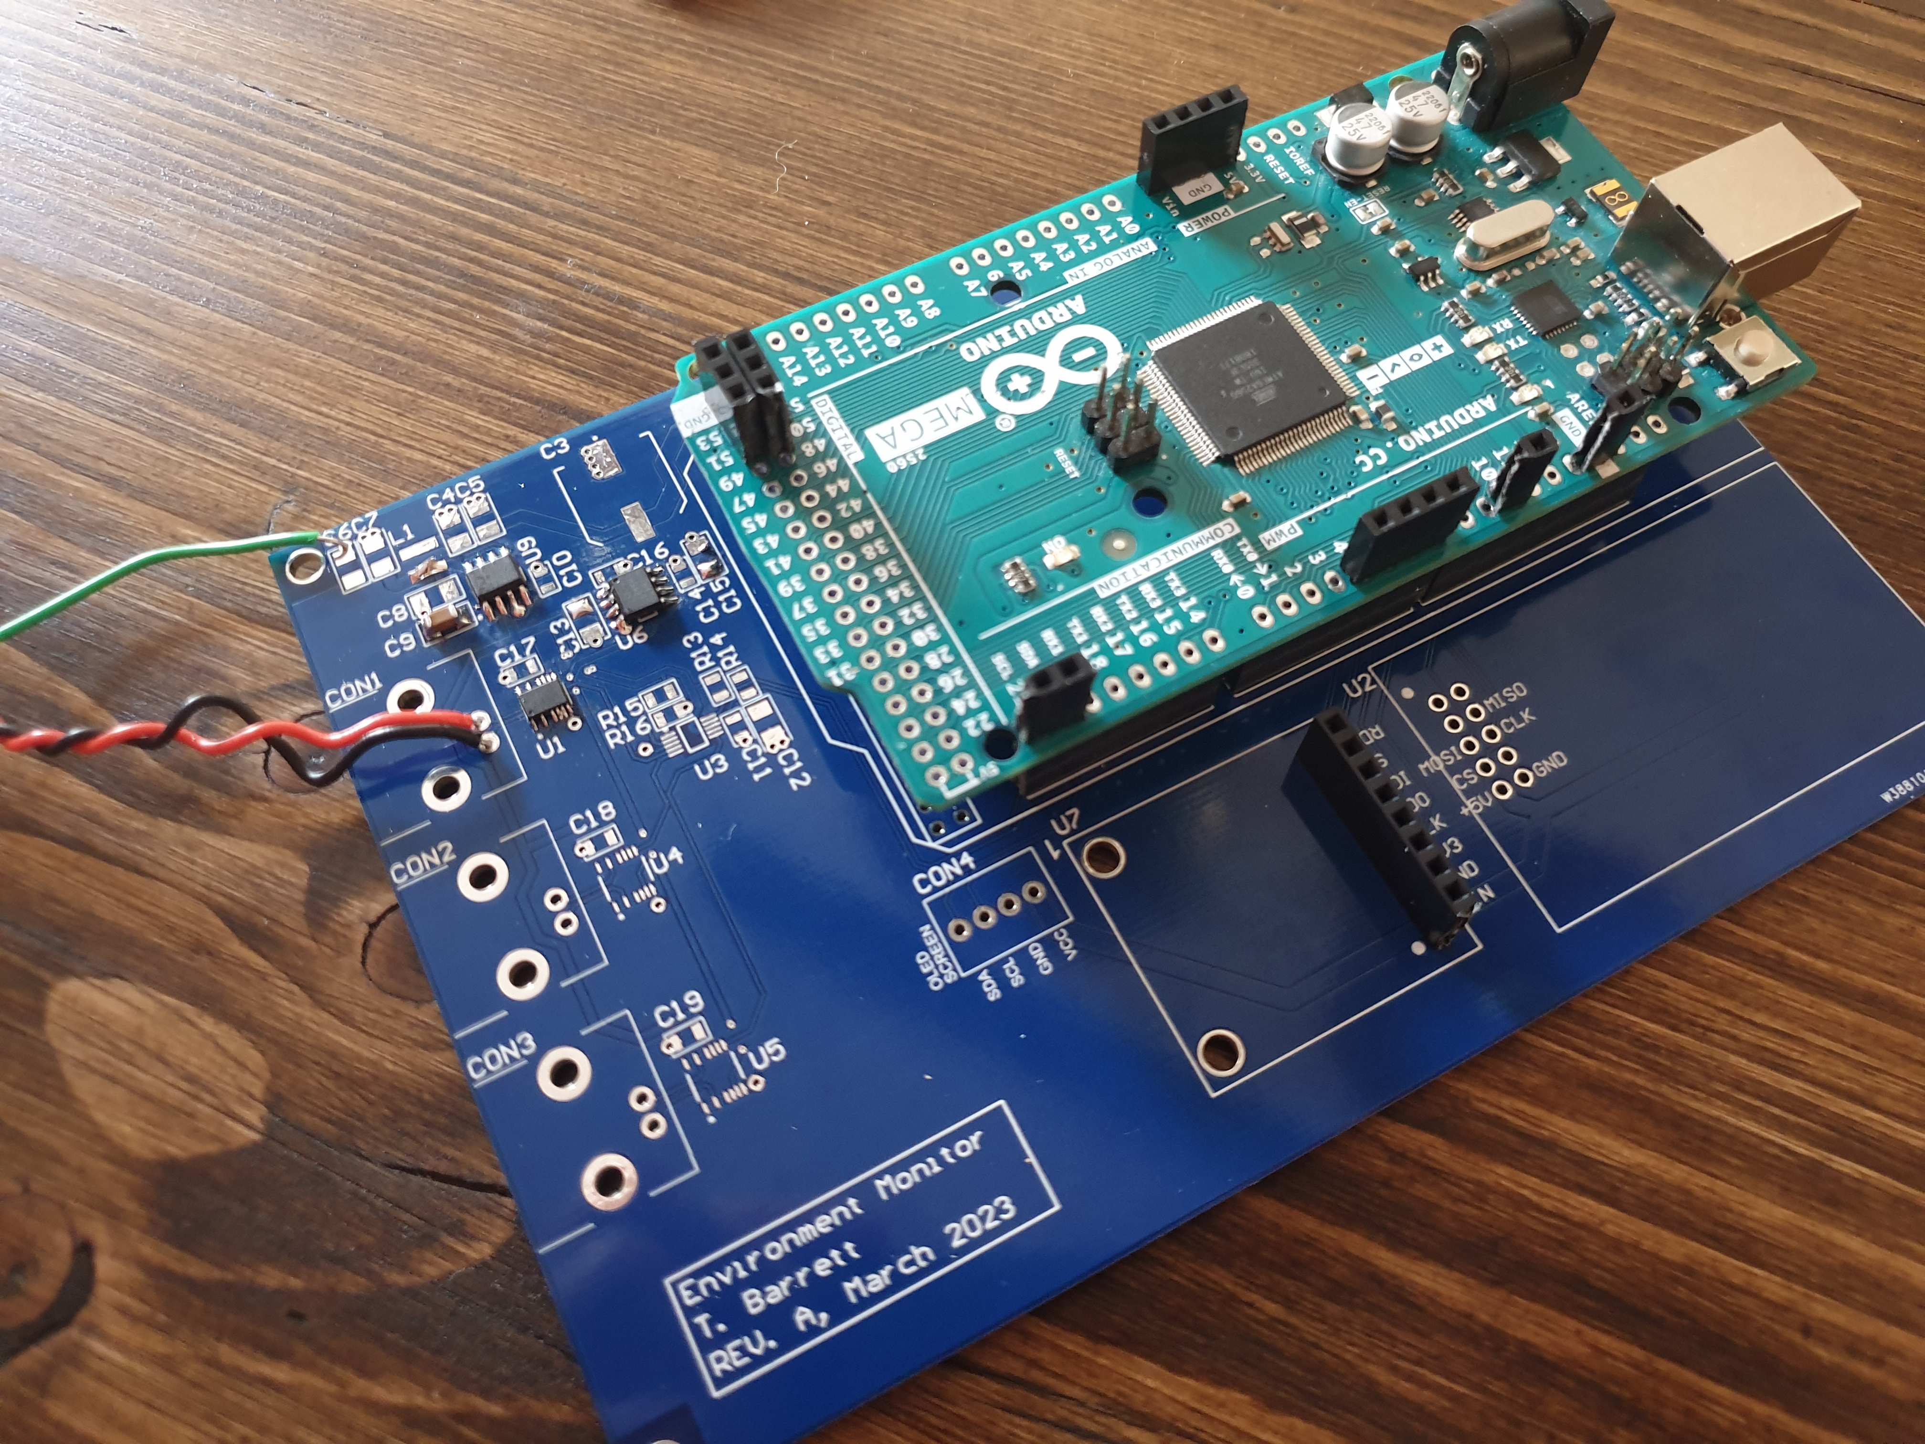
Assembled Board

Slide 7
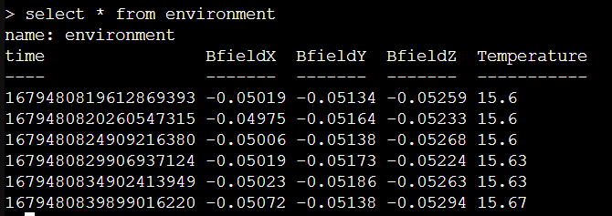
Structure of Firmware
Power On
Startup functions → Initialise ethernet chip, ADC, and PT100 converter
MAIN LOOP (every X seconds, e.g. every 20 sec)
Collect N readings from ADC channel 1 and take average (takes 1.73 ms per reading, e.g. 173ms for 100 readings)
Collect N readings from ADC channel 2 and take average (takes 1.73 ms per reading, e.g. 173ms for 100 readings)
Collect N readings from ADC channel 3 and take average (takes 1.73 ms per reading, e.g. 173ms for 100 readings)
~620 ms
Obtain PT100 reading (takes 77 ms)
Connect to remote InfluxDB server, post data, read response, disconnect from server (takes 25 ms)
Update OLED display screen
Data format in InfluxDB
(each datapoint is a field, with no tags).
All fields share a common time-stamp (may be useful later if wanting to do correlation, etc)

Slide 8
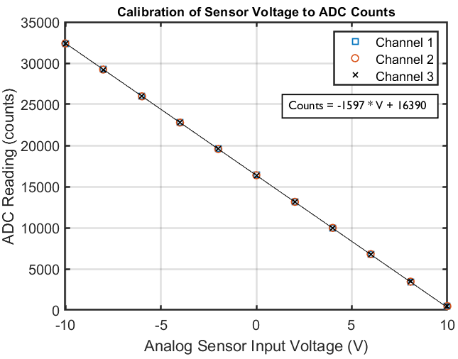
ADC Calibration of all channels
Note:
Although the ADS1115 ADC is technically a 16 bit ADC (and should therefore go up to 65,536 counts), this is only true when working in differential mode. In that case, one of the 16 bits is the sign bit, and the other 15 bits are for data. However, differential mode requires dedicating x2 of the ADC inputs, and I would need to have then 6 channels available for all 3 magnetic field directions. The ADC only has 4 channels though, so to avoid needing a second ADC, I am running each channel in single-ended mode. This means you can never get negative values, and so effectively sacrifice the sign bit, leaving an effective 15 bit resolution (32,768 values).
Counts = -1599.6 * V + 16379
Expected 0.000125 volts per bit from ADC setting gain=1
This is 8000 counts per volt.
Expected additional gain of 0.2 from LT1997-2 funnel amplifier
So expect: 8000 x 0.2 = 1600 counts / volt
This is close to the measured value of 1599.6 counts / volt

Slide 9
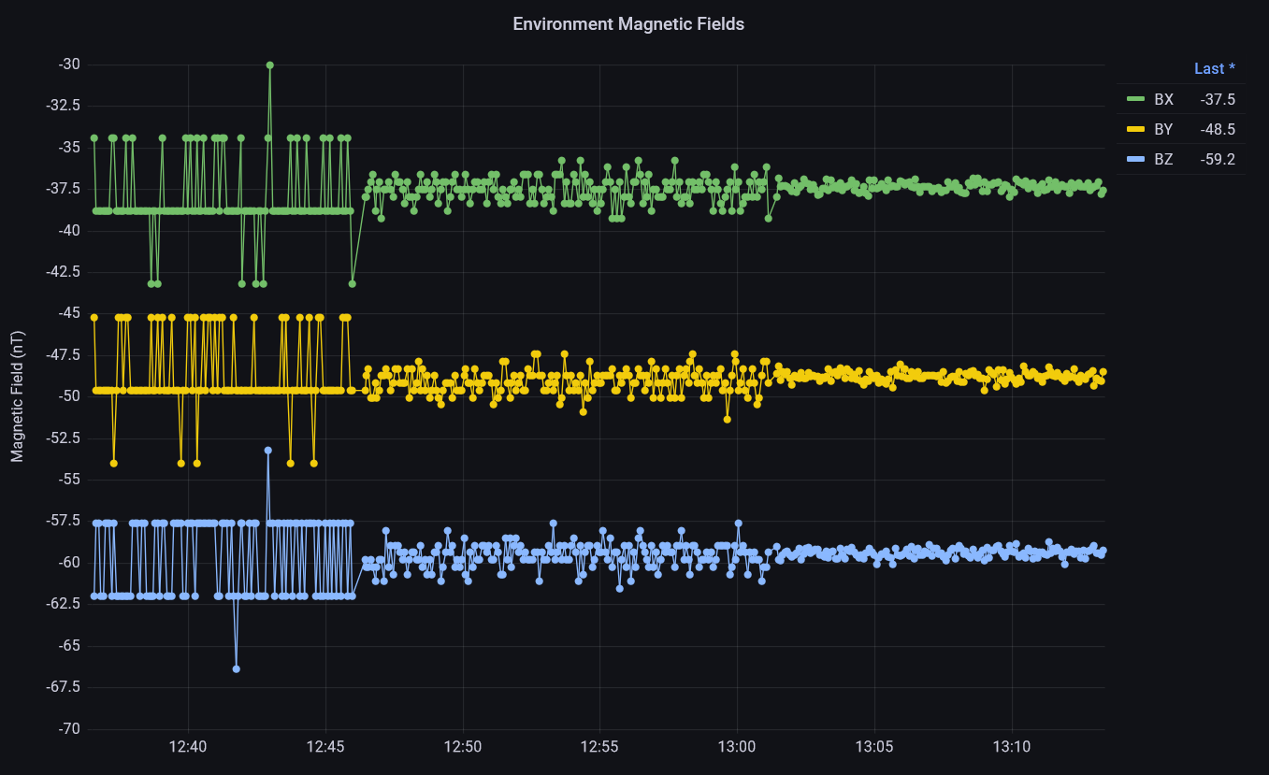
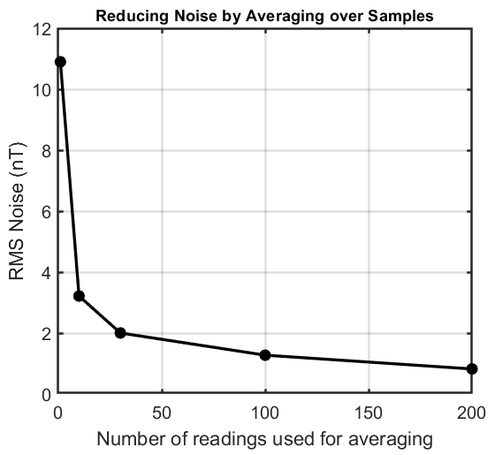
Effect of averaging the ADC Counts before posting to InfluxDB
No ADC averaging
Averaging over 10 ADC readings
Averaging over 100 ADC readings
1.2 nT RMS noise
1 count = 4.38 nT

Slide 10
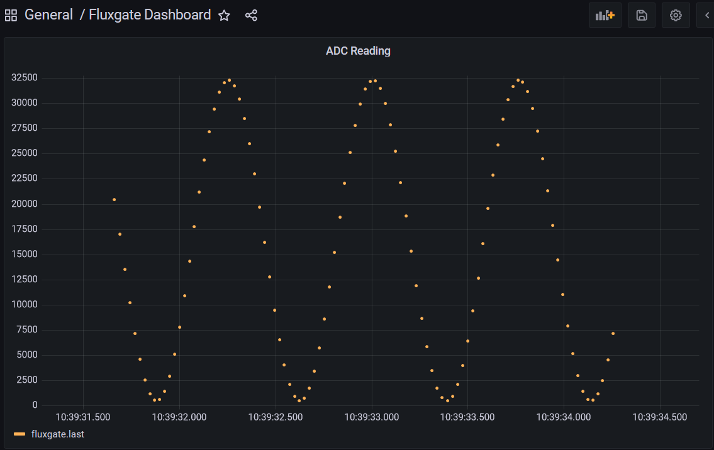
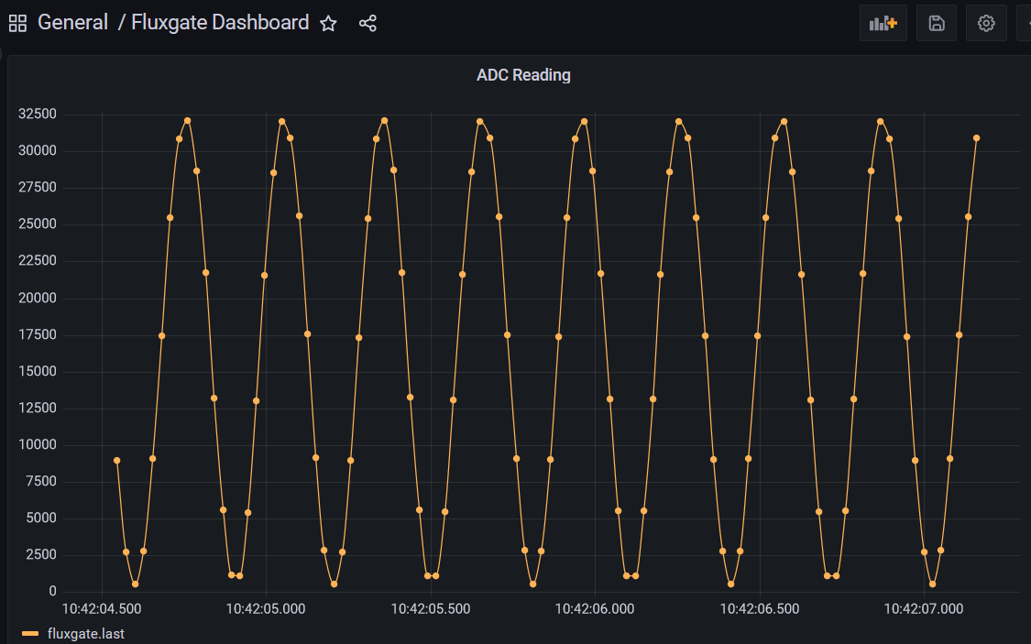
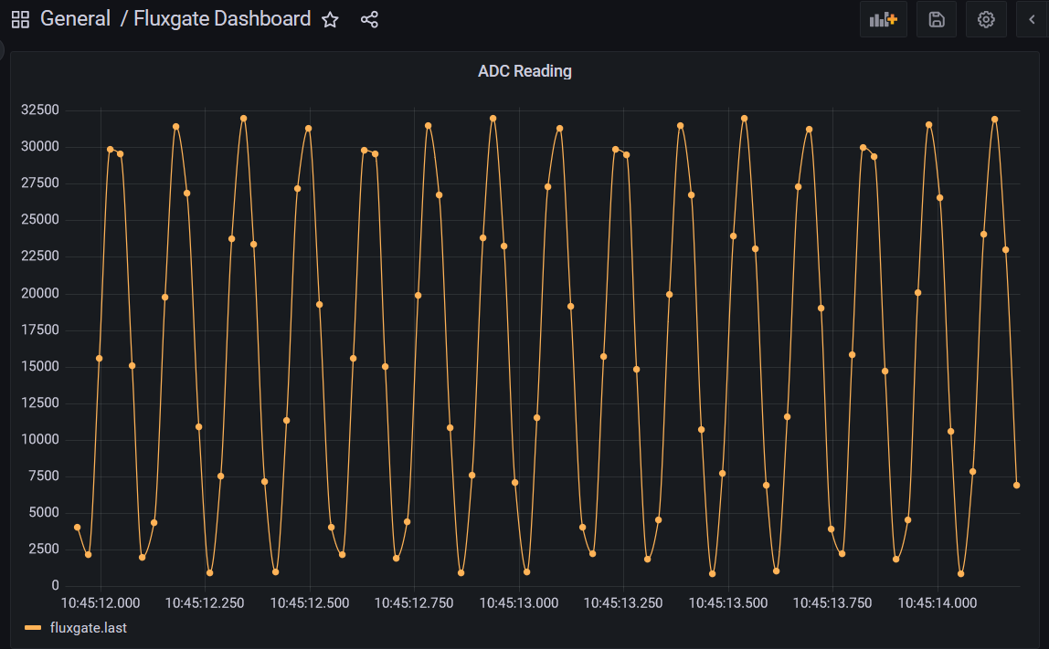
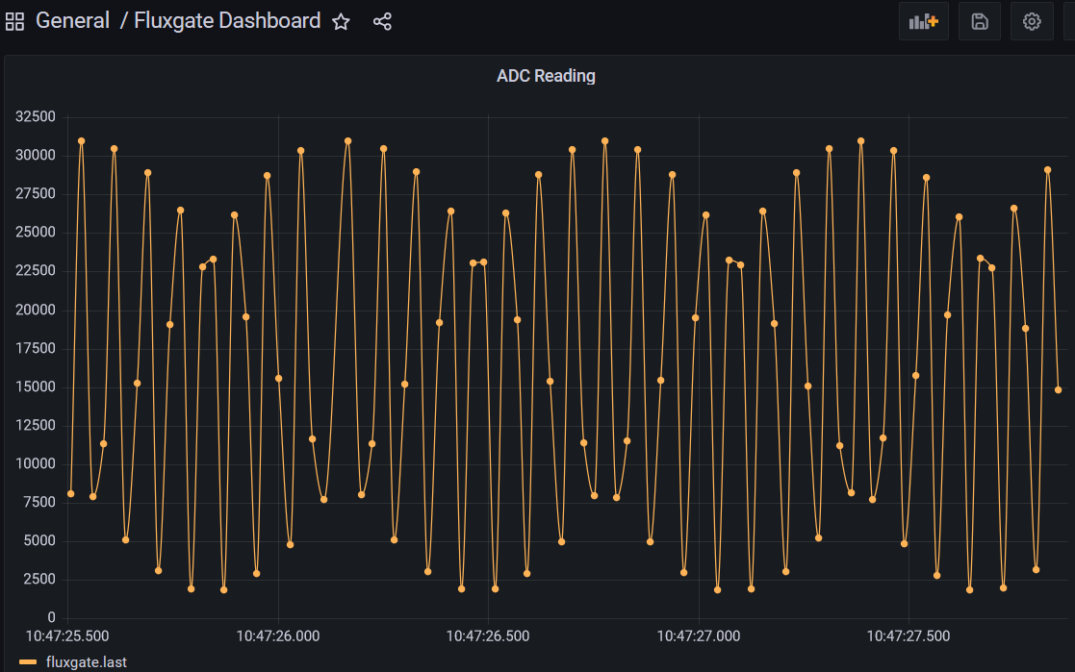
Measuring a 20 Hz sine wave
Measuring a 50 Hz sine wave
Measuring a 100 Hz sine wave
Measuring a 200 Hz sine wave (some aliasing)

Slide 11
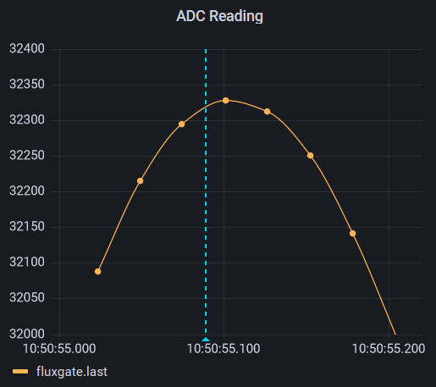
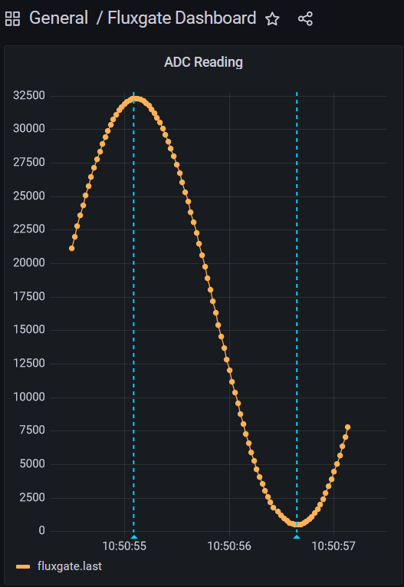
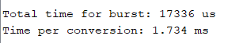
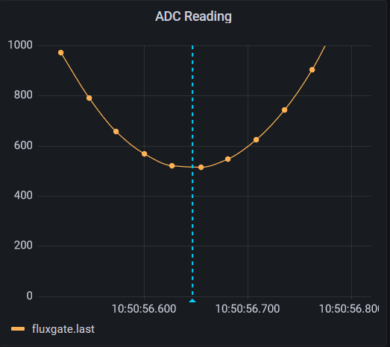
5 Hz sine wave, 20 V p-p (+-10V)
Measuring the time to collect 10 values from ADC:
Corresponds to 577 samples / second (should be able to measure up to 288 Hz signals without aliasing)
Max and min counts seems to be around 32330 and 520 counts
→ means I am able to capture the full +-10V range successfully.

Slide 12
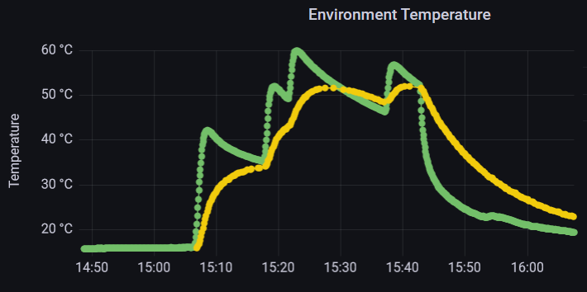
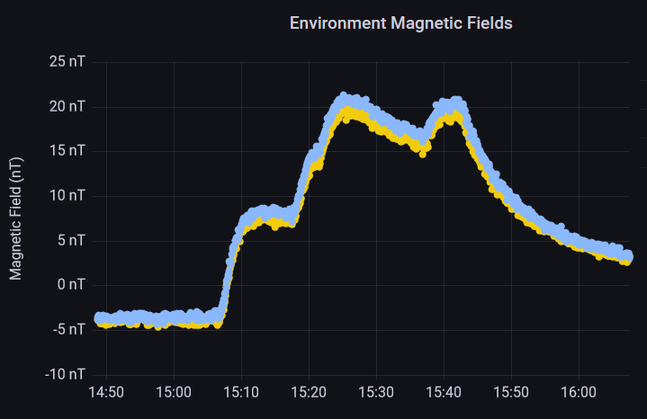
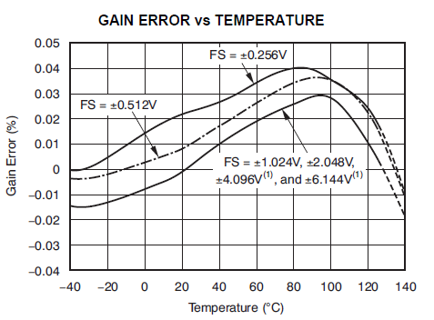
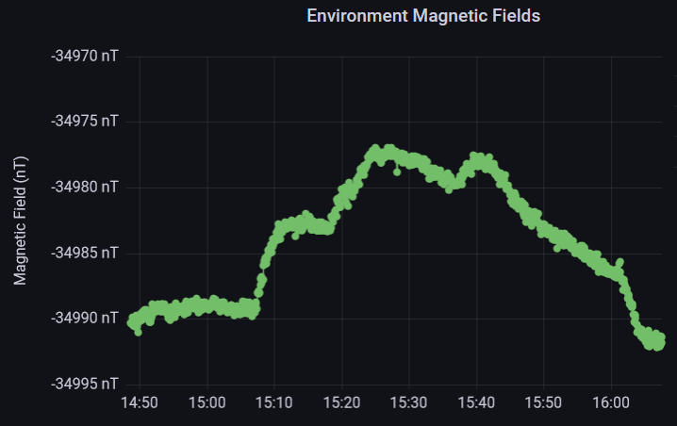
Checking Behaviour of System when Heated to 50°C
Applied a BX field of -34990 nT (5V) , and a BZ field of 0 nT.
BZ changed by 12 nT when Temperature went from 16 to 35 °C
BX changed by 6 nT when Temperature went from 16 to 35 °C
BZ changed by 12 nT when Temperature went from 35 to 52 °C
BX changed by 5 nT when Temperature went from 35 to 52 °C
BZ changes by 12 nT in 18°C, or 0.67 nT / °C
BX changes by 6 nT in 18°C, or 0.33 nT / °C
At 50°C, we can expect a change of ~12-24 nT from room temperature. This corresponds to 2.5 – 5.5 ADC counts.
LT1997-2 has a gain error of 1 ppm/°C (0.2 ppm/°C typical).
ADS1115 datasheet says we can expect 0.015% change in gain when increasing from room temperature up to 50°C

Slide 13
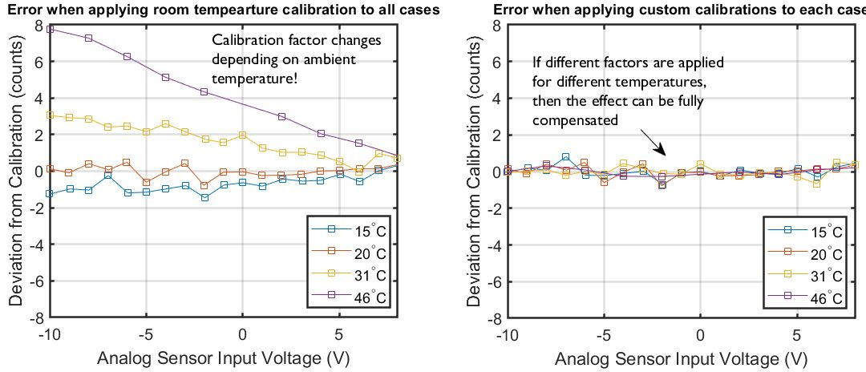
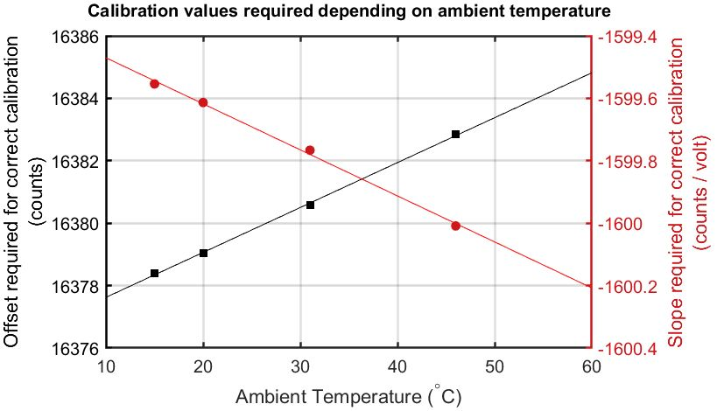
Temperature Dependence of Calibration Factors
A temperature-dependent calibration factor was therefore included in the firmware. (i.e. first we measure the temperature, and then calculate the most appropriate calibration factors – offset and slope - to use)

Slide 14
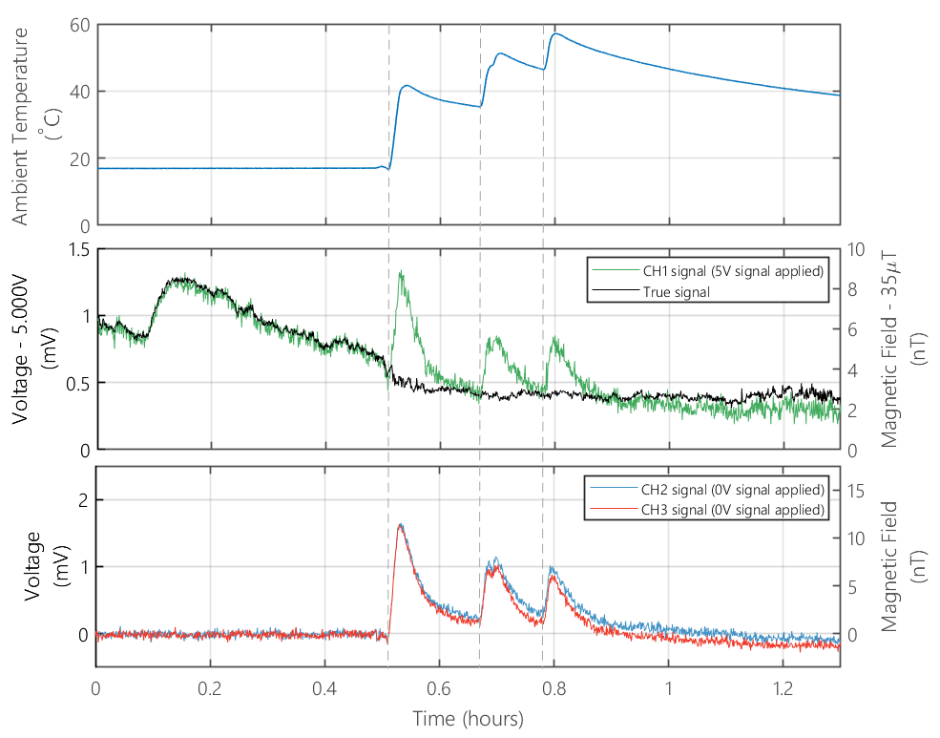
Behaviour of system when heated to 50°C after adding temperature-dependent calibration
Since the system is heated up fast (in an oven), the PT100 probe heats up faster than the analog circuitry on the PCB, and so there is a delay of around 5 minutes before the calibration becomes accurate.
In the real system, when dealing with slow changes to the room temperature, this will not be present.
The error in the magnetic field reading is now less than 1nT at 50 °C.
This is a big improvement on the error of 24nT before, when the temperature –dependent calibration was not used.

